Slide 1

Week 10 : SOFTWARE DEVELOPMENT TOOLS AND ENVIRONMENTS

Slide 2





Dockerfile and Docker Image

Slide 3
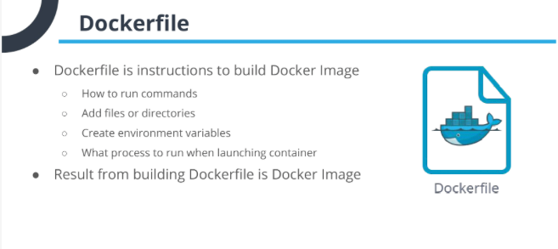

Slide 4
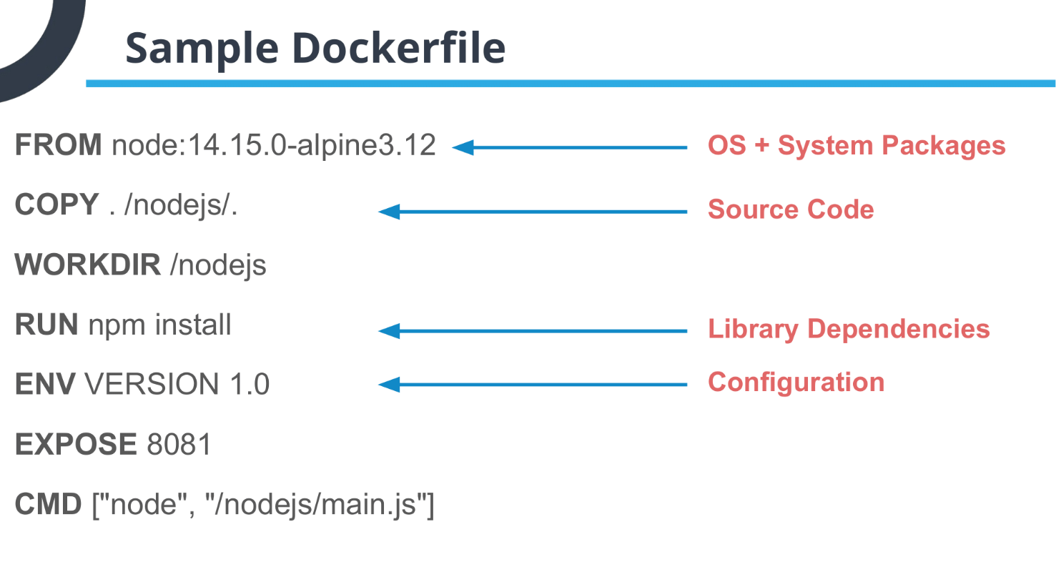

Slide 5
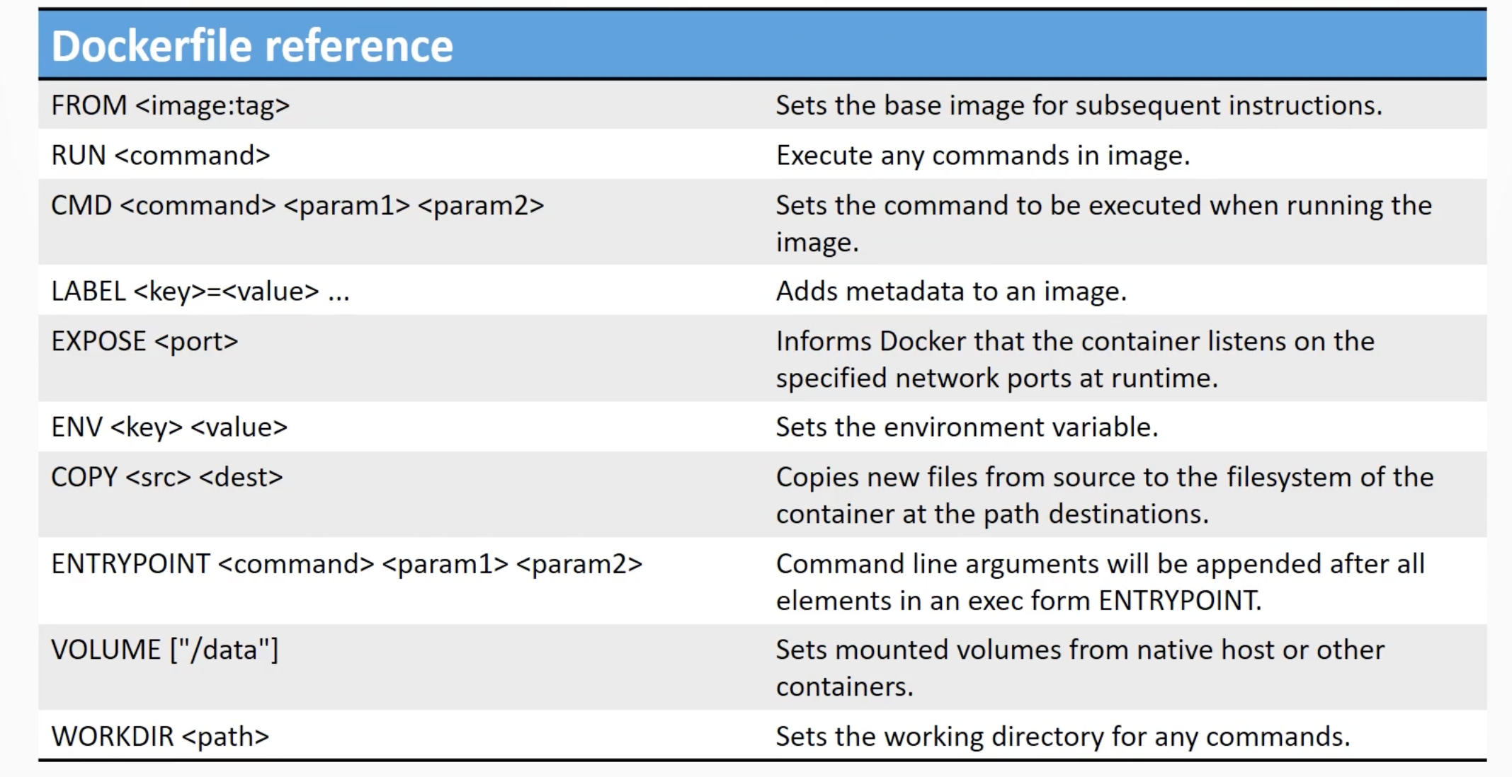

Slide 6



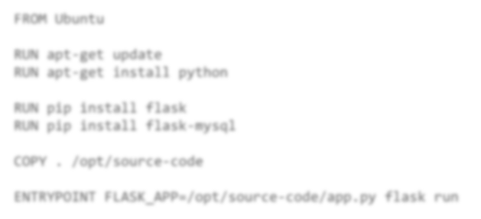





How to create my own image?
Dockerfile
FROM Ubuntu
1. OS - Ubuntu
RUN apt-get update
RUN apt-get install python
2. Update apt repo
RUN pip install flask
RUN pip install flask-mysql
3. Install dependencies using apt
4. Install Python dependencies using pip
COPY . /opt/source-code
ENTRYPOINT FLASK_APP=/opt/source-code/app.py flask run
5. Copy source code to /opt folder
6. Run the web server using “flask” command
docker build Dockerfile –t mmumshad/my-custom-app
docker push mmumshad/my-custom-app
Docker Registry

Slide 7





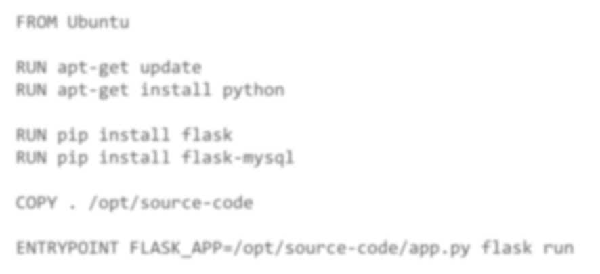

Dockerfile
Dockerfile
INSTRUCTION
ARGUMENT
Dockerfile
FROM Ubuntu
Start from a base OS or
another image
RUN apt-get update
RUN apt-get install python
Install all dependencies
RUN
pip install flask
RUN pip install flask-mysql
COPY . /opt/source-code
ENTRYPOINT FLASK_APP=/opt/source-code/app.py flask run
Copy source code
Specify Entrypoint

Slide 8


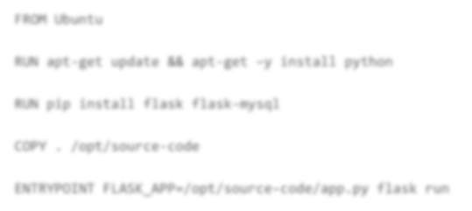




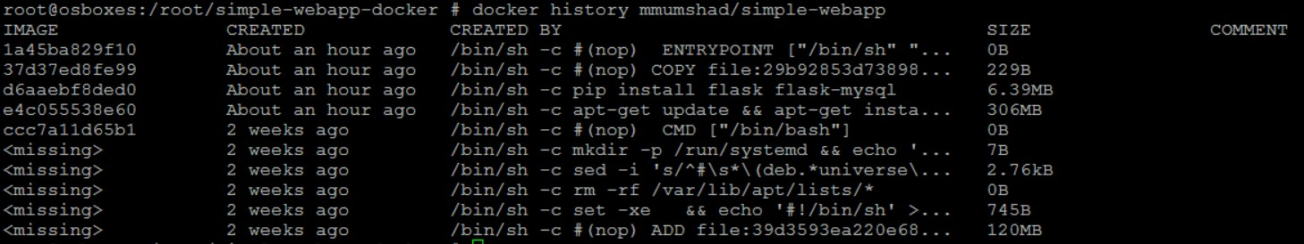
Layered architecture
Dockerfile
docker build Dockerfile –t mmumshad/my-custom-app
FROM Ubuntu
Layer 1. Base Ubuntu Layer
120 MB
RUN apt-get update && apt-get –y install python
Layer 2. Changes in apt packages
306 MB
RUN pip install flask flask-mysql
Layer 3. Changes in pip packages
6.3 MB
COPY . /opt/source-code
Layer 4. Source code
229 B
ENTRYPOINT FLASK_APP=/opt/source-code/app.py flask run
Layer 5. Update Entrypoint with “flask” command
0 B

Slide 9
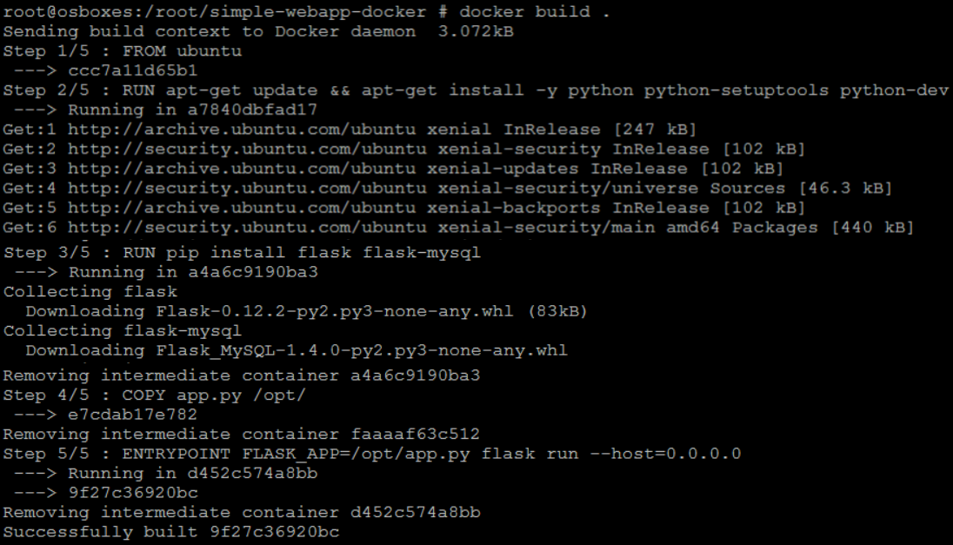
Docker build output

Slide 10

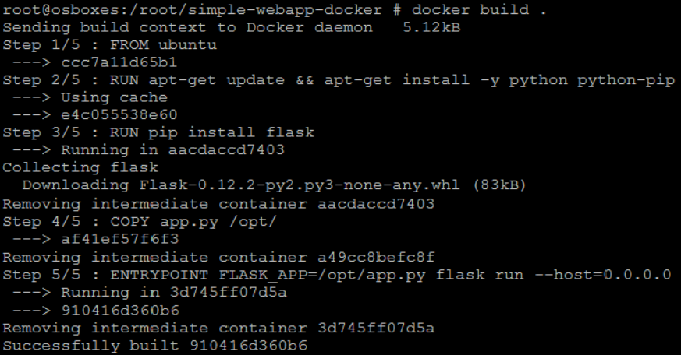


failure
docker build Dockerfile –t mmumshad/my-custom-app
Layer 1. Base Ubuntu Layer
Layer 2. Changes in apt packages
Layer 3. Changes in pip packages
Layer 4. Source code
Layer 5. Update Entrypoint with “flask” command

Slide 11
Docker registry

Slide 12

Image
docker run nginx

Slide 13



Image
docker.io Docker Hub
image:
docker.io/ nginx/nginx
Registry User/ Image/
Account Repository
gcr.io/ kubernetes-e2e-test-images/dnsutils

Slide 14

Private Registry
docker login hub.docker.com
Login with your Docker ID to push and pull images from Docker Hub. If you don't have a Docker ID, head over to https://hub.docker.com to create one.
Username: registry-user
Password:
WARNING! Your password will be stored unencrypted in /home/vagrant/.docker/config.json.
Login Succeeded
docker run private-registry.io/apps/internal-app

Slide 15
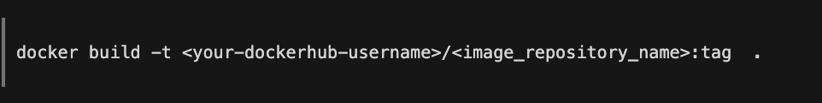
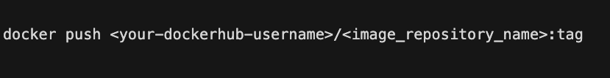
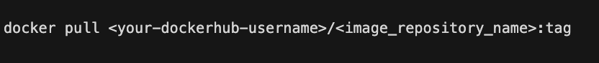
Deploy Private Registry

Slide 16
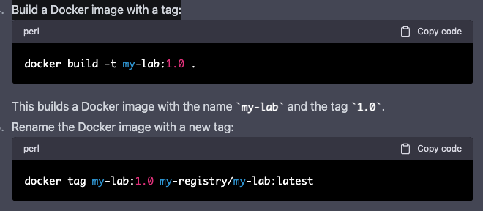
How to rename image with Docker tag

Slide 17
Docker Network

Slide 18








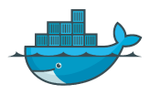
Default networks
Bridge
none
host
docker run ubuntu
docker run Ubuntu –-network=none
docker run Ubuntu --network=host
Docker Host
 | 5000 |  |  |  | 5000
Web Container |  |  |  | Web Container
Docker Host
Web
Container
172.17.0.2
Web
Container
172.17.0.3
Web
Container
172.17.0.1
docker0
172.17.0.4
Web
Container
172.17.0.5
Web
Container
Docker Host

Slide 19
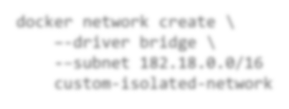


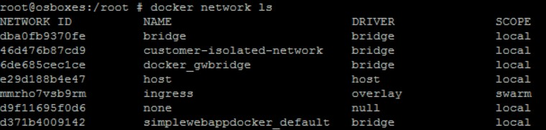
User-defined networks
Web
Container
172.17.0.2
docker network create \
–-driver bridge \
-–subnet 182.18.0.0/16 custom-isolated-network
Web
Container
1782.178.0.3
172.17.0.1
docker0
182.18.0.1
docker0
172.17.0.4
Web
Container
1782..178..0..52
Web
Container
docker network ls
Docker Host

Slide 20

Inspect Network
docker inspect blissful_hopper
[
{
"Id": "35505f7810d17291261a43391d4b6c0846594d415ce4f4d0a6ffbf9cc5109048",
"Name": "/blissful_hopper",
"NetworkSettings": { "Bridge": "",
"Gateway": "172.17.0.1",
"IPAddress": "172.17.0.6",
"MacAddress": "02:42:ac:11:00:06", "Networks": {
"bridge":
{
"Gateway": "172.17.0.1",
"IPAddress": "172.17.0.6",
"MacAddress": "02:42:ac:11:00:06",
}
}
}
]

Slide 21


Embedded DNS
Host
IP
mysql.connect( mysql )
web
Container
mysql
Container
web
172.17.0.2
172.17.0.3
172.17.0.2
172.17.0.3
mysql
172.17.0.3
docker0
DNS
Server
127.0.0.11
Docker Host

Slide 22
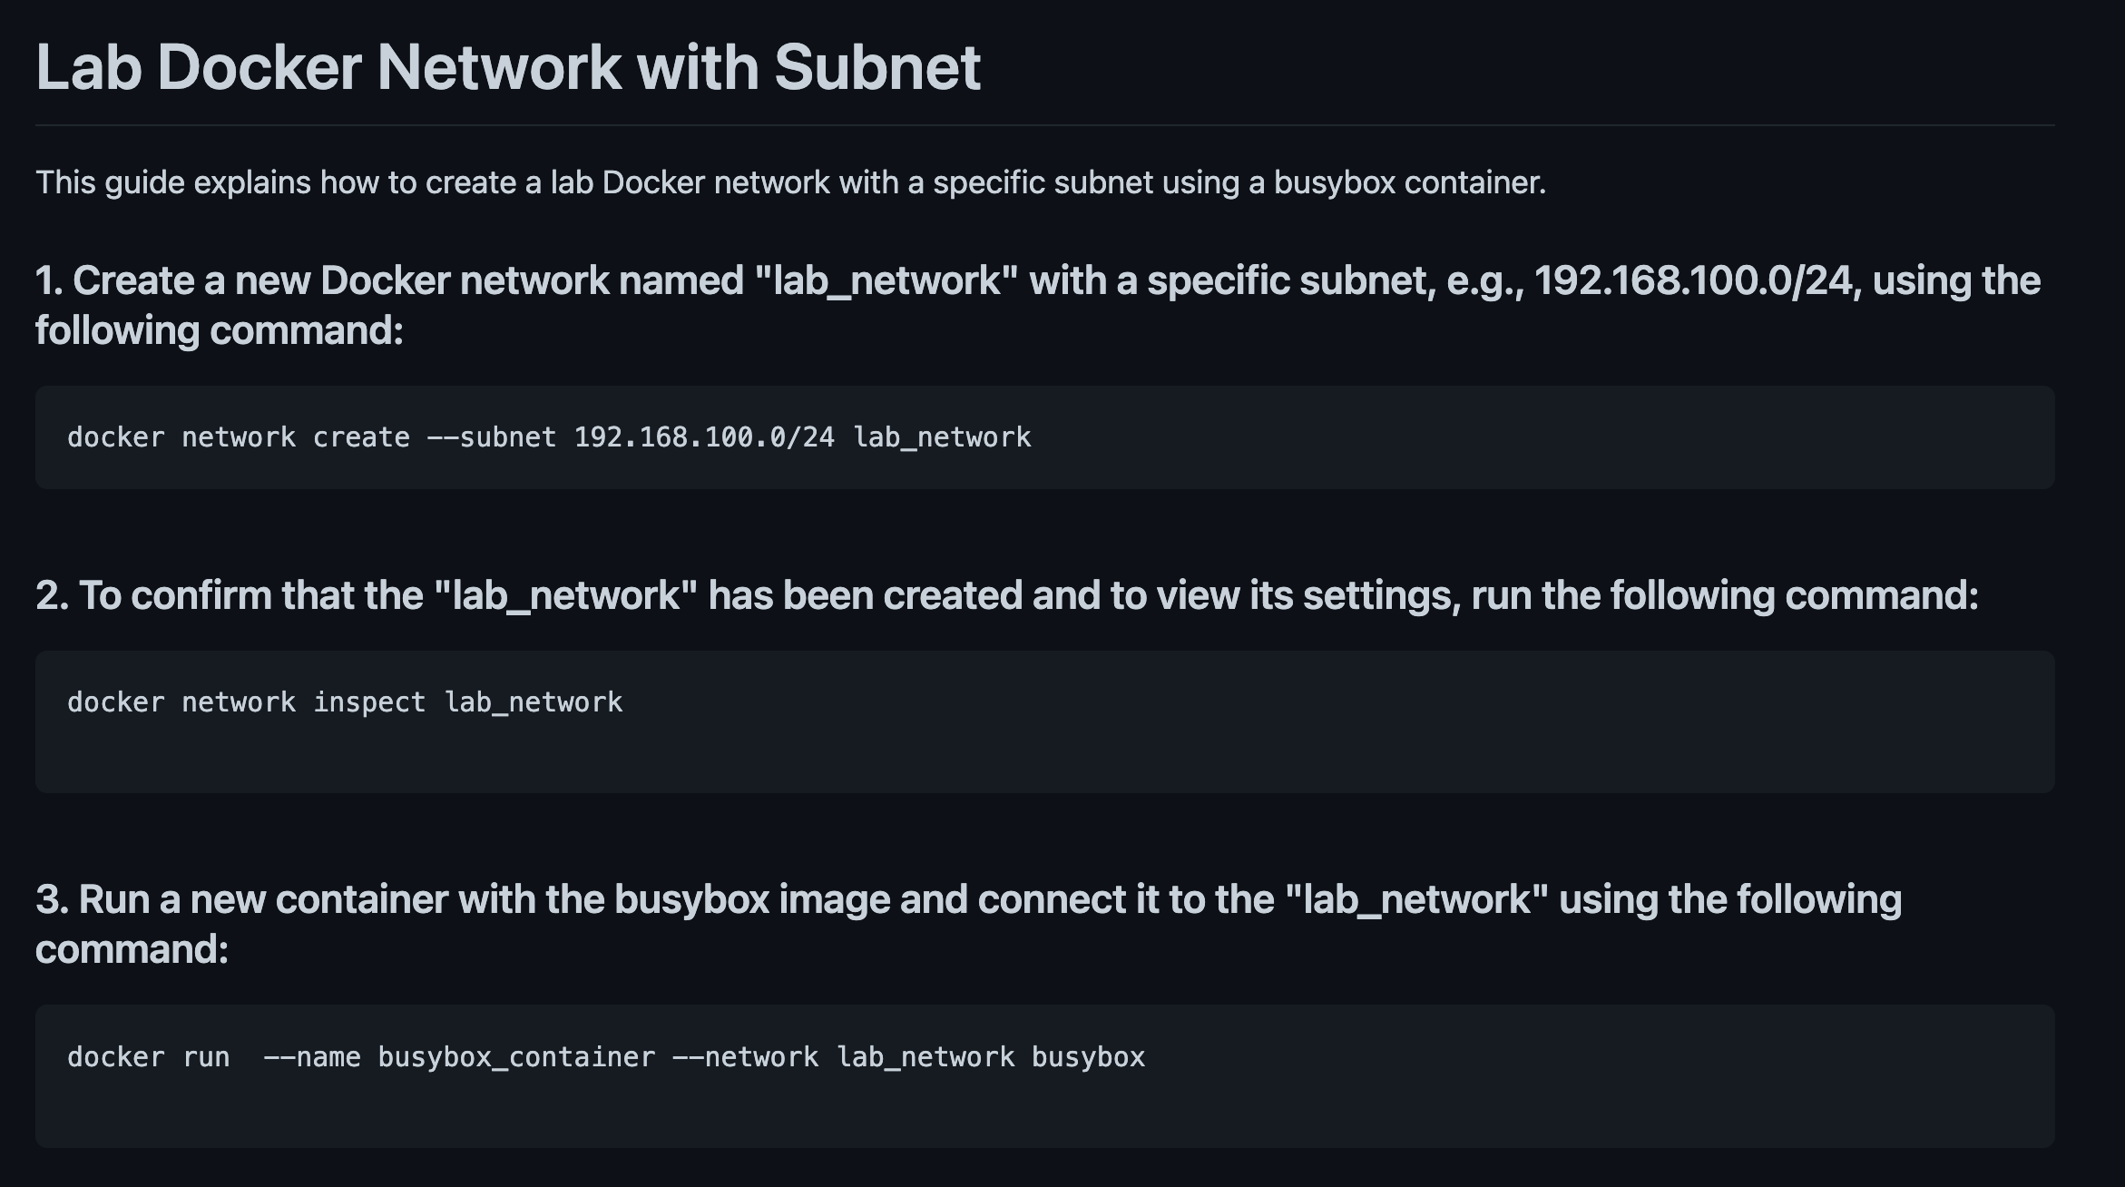

Slide 23
Docker compose

Slide 24
















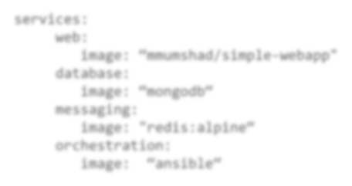




Docker compose
Public Docker registry - dockerhub
docker run yourname/simple-webapp
docker run mongodb
docker run redis:alpine
docker run ansible
docker-compose.yml
services:
web:
image: “yourname/simple-webapp"
database:
image: “mongodb“
messaging:
image: "redis:alpine“ orchestration:
image: “ansible“
docker-compose up

Slide 25
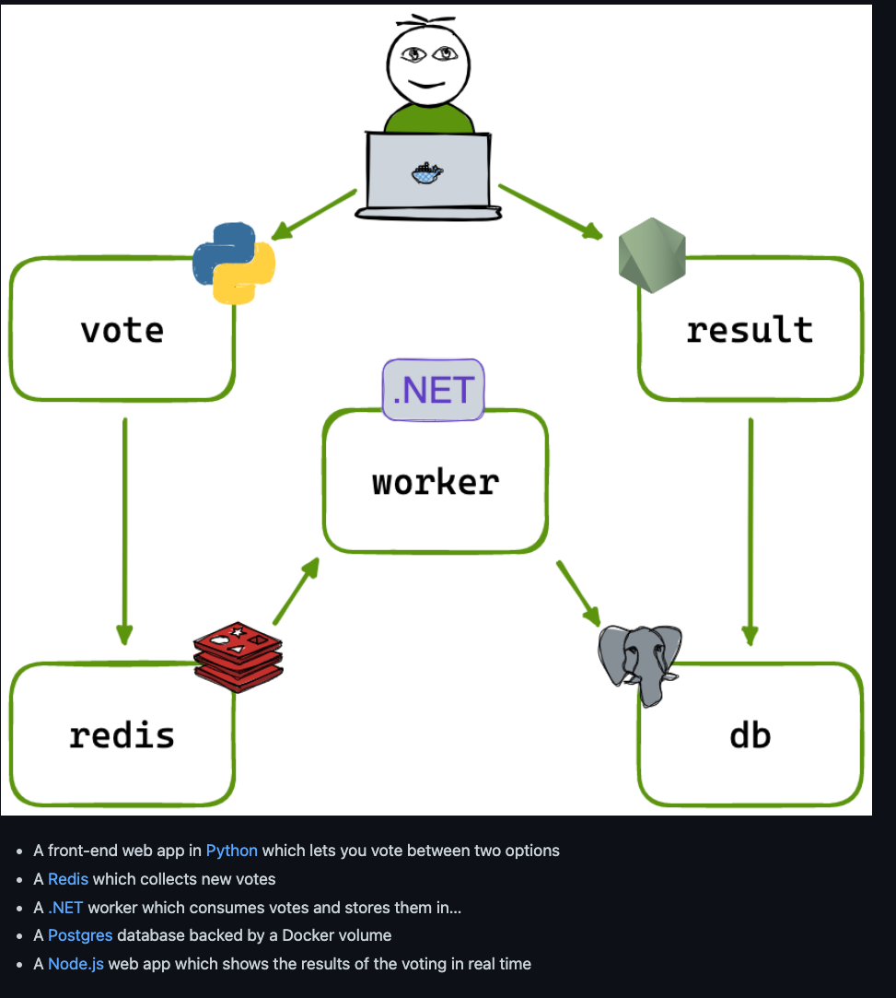
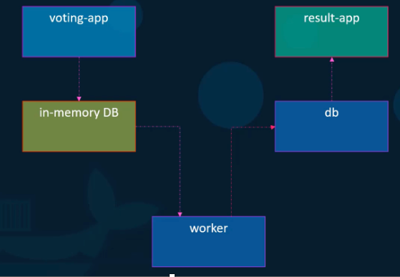

Slide 26
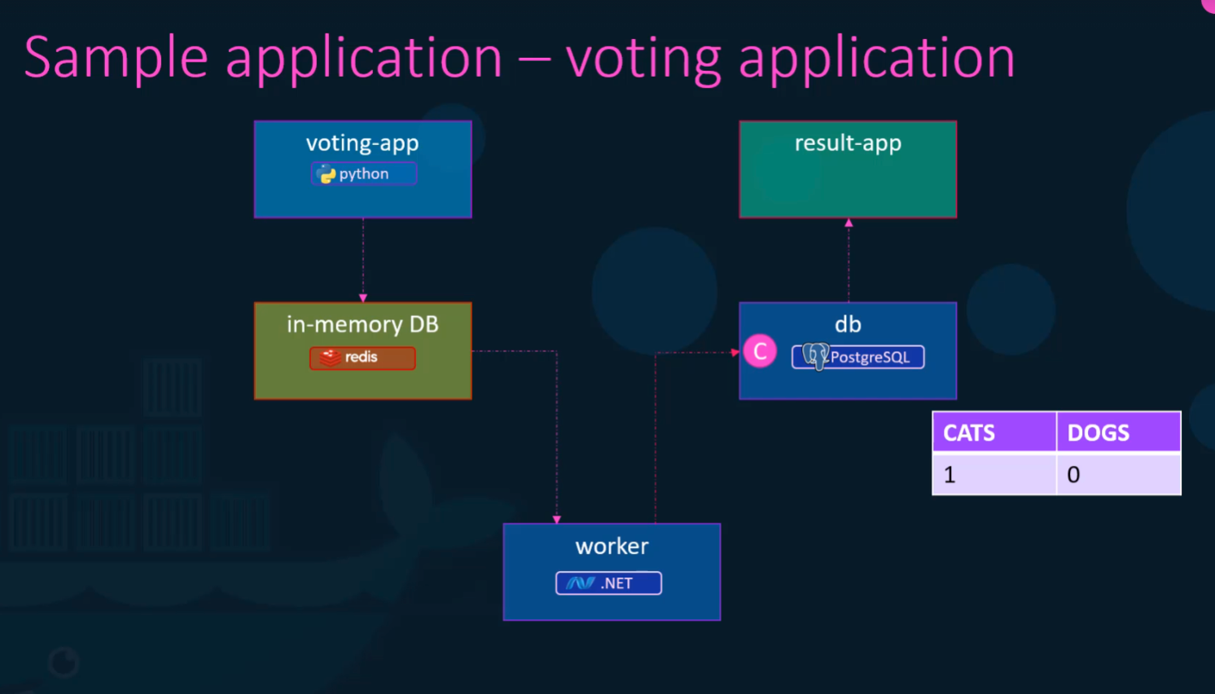

Slide 27
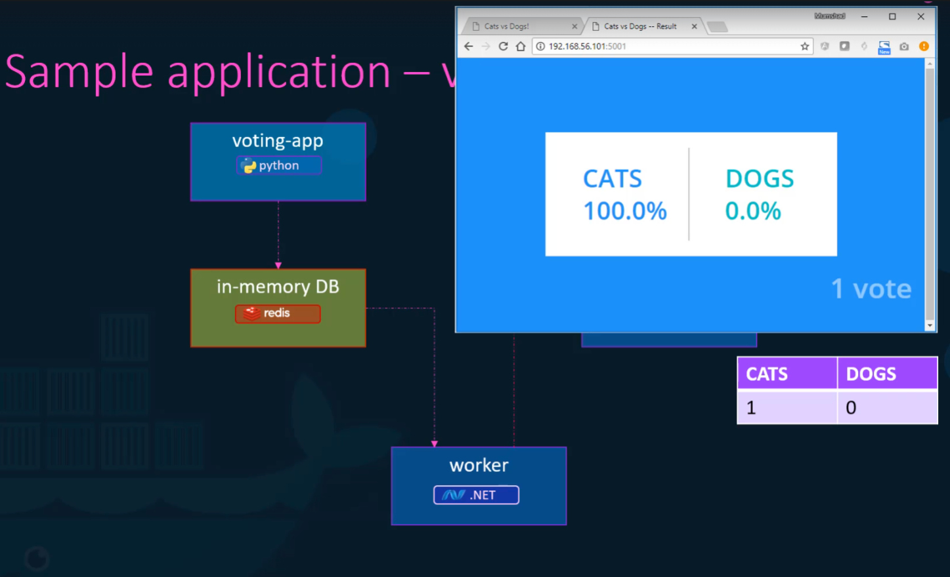

Slide 28
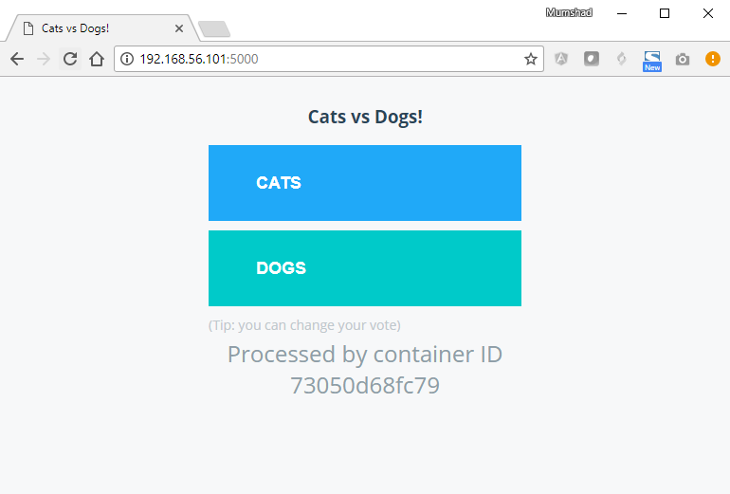
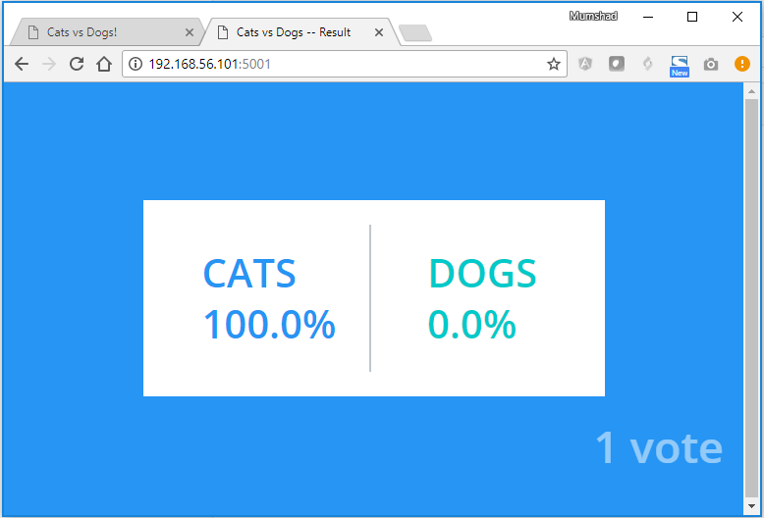




Sample application –
voting-app
python
C
in-memory DB
voting application
result-app
NodeJS
db
PostgreSQL
CATS | DOGS
1 | 0
CATS
DOGS
0
0
worker
.NET

Slide 29
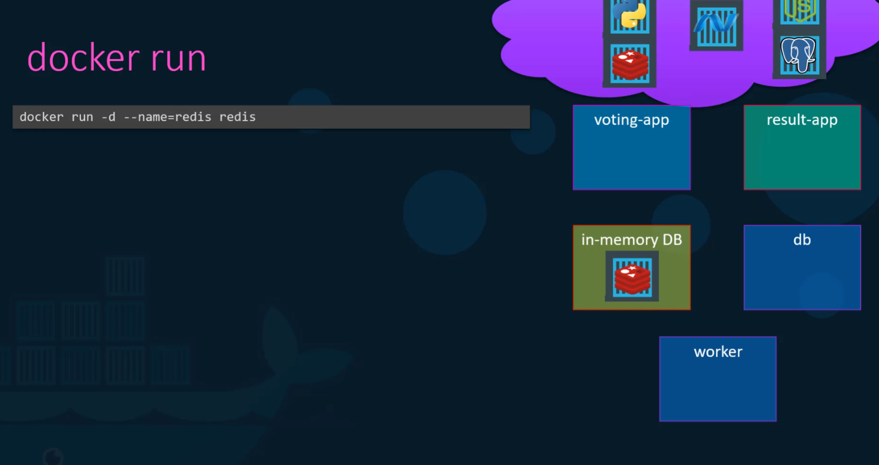

Slide 30
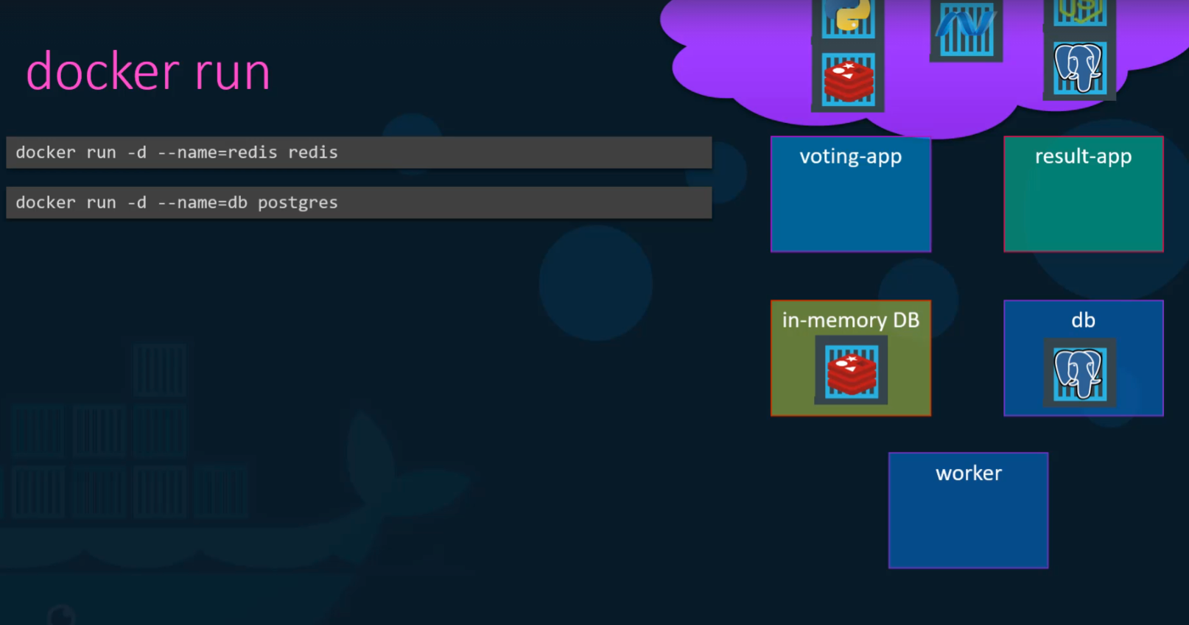

Slide 31
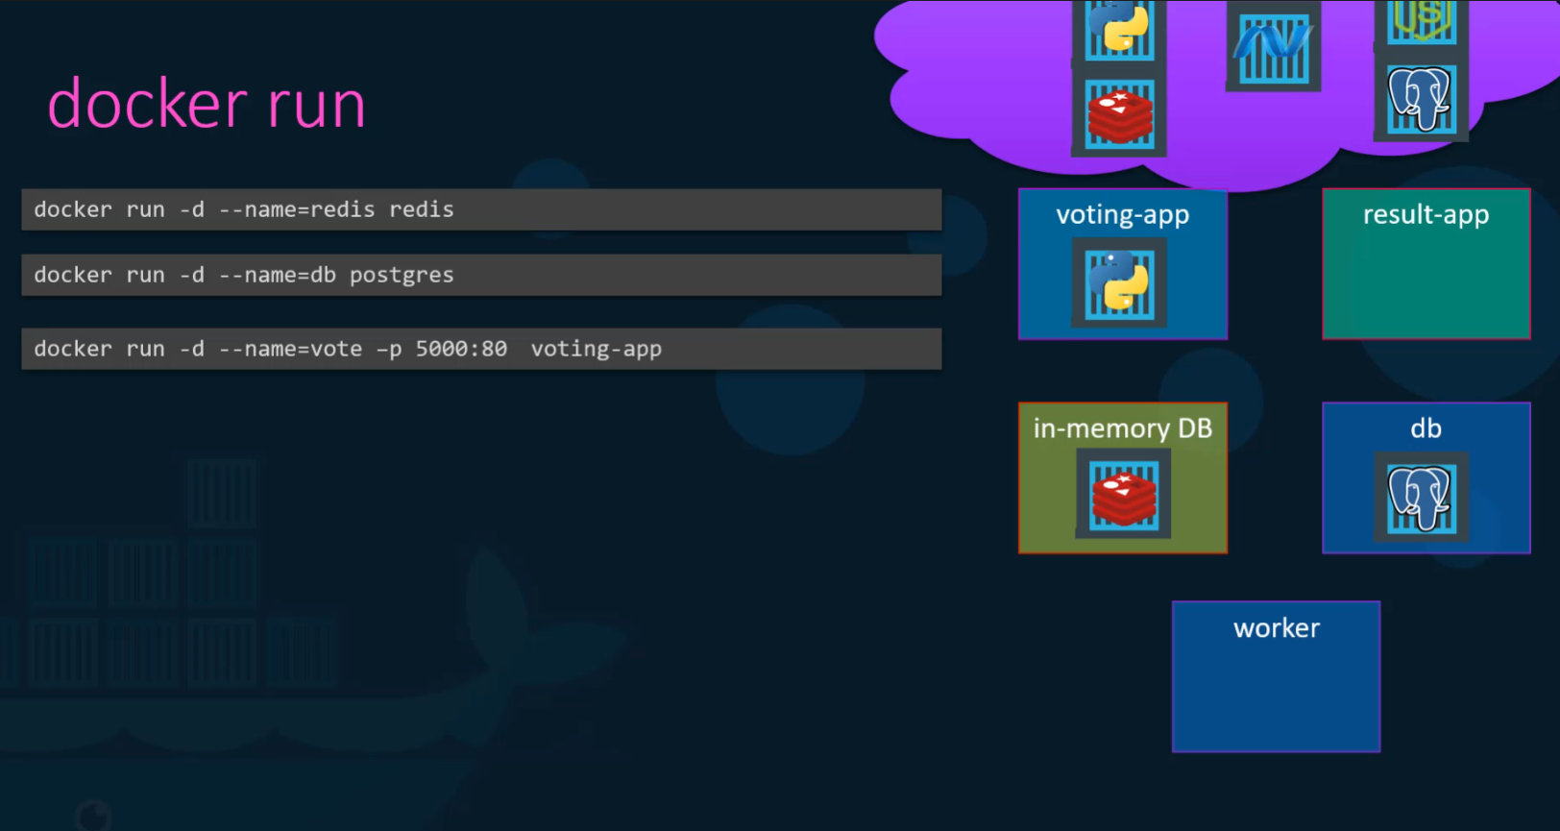

Slide 32
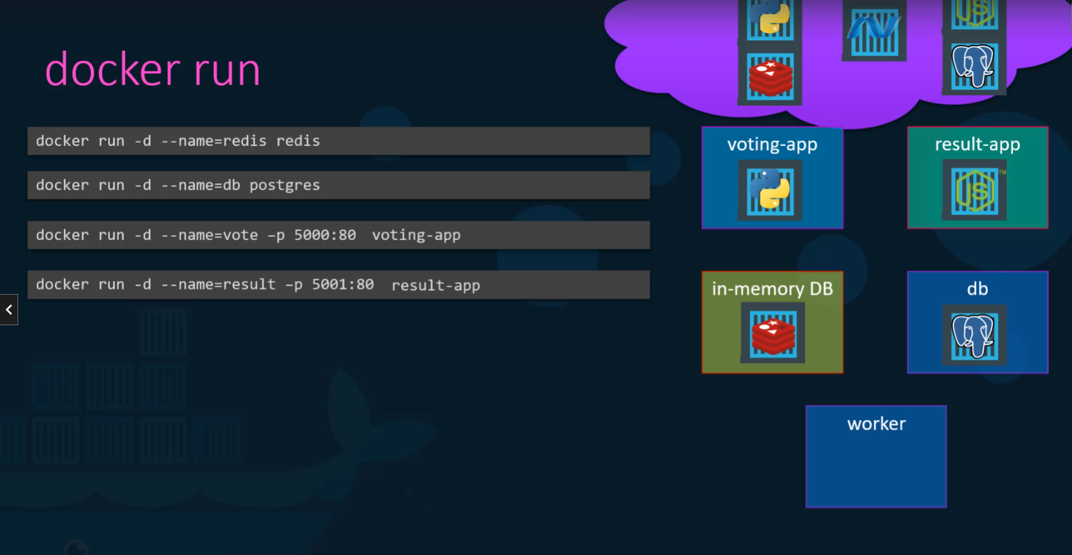

Slide 33
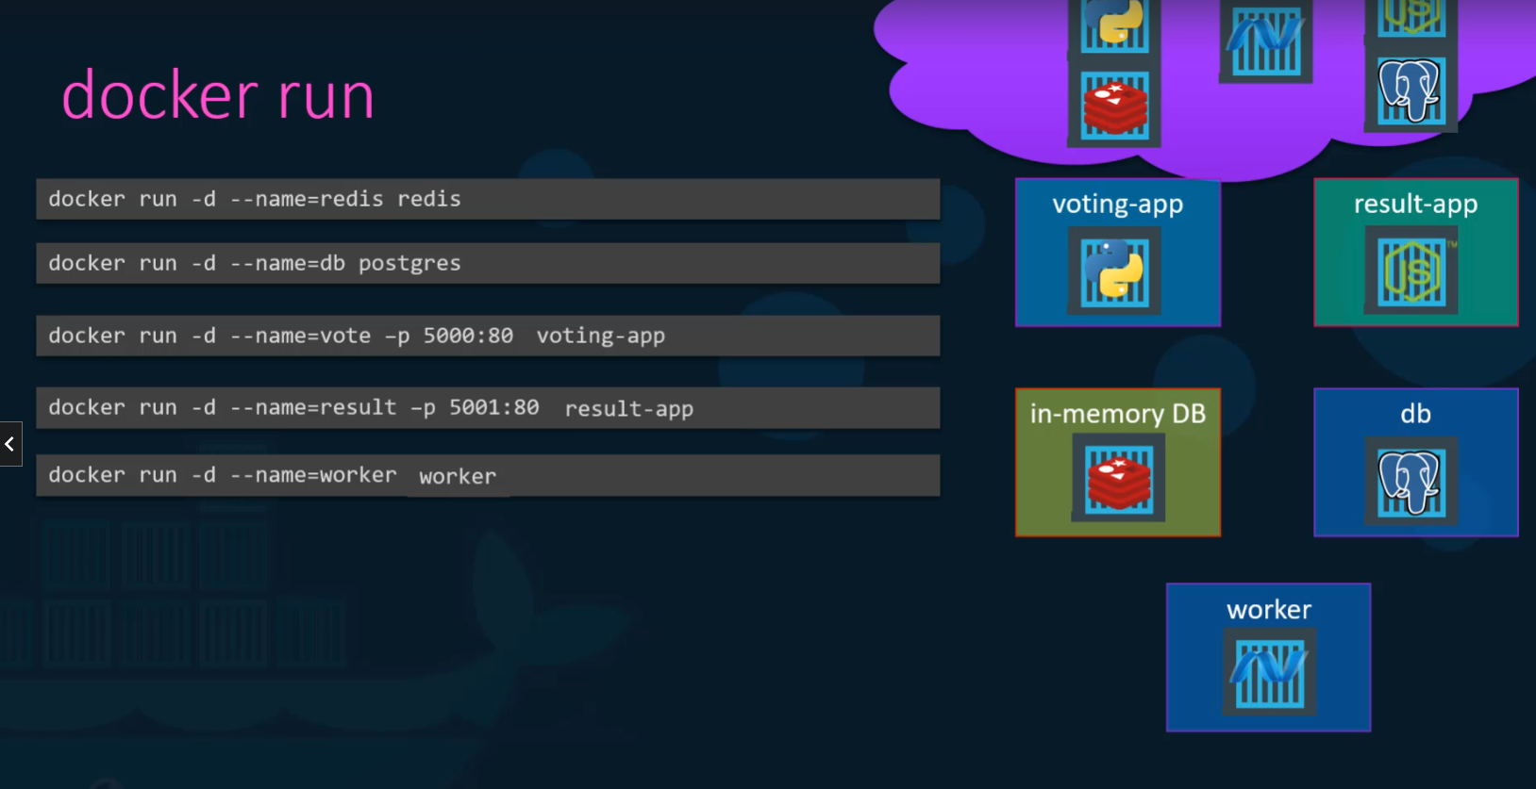

Slide 34
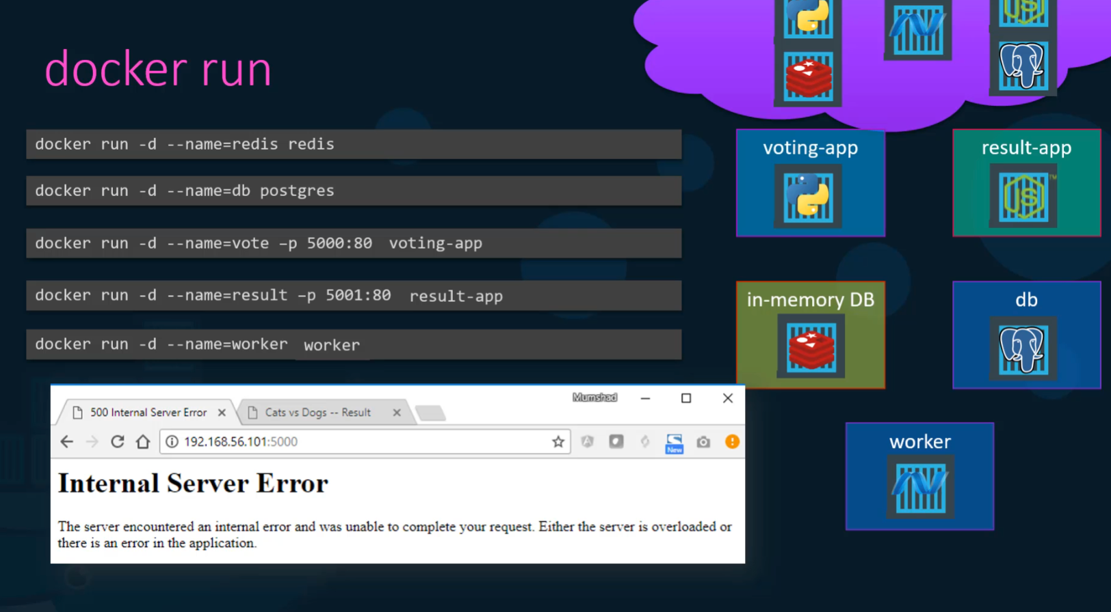

Slide 35
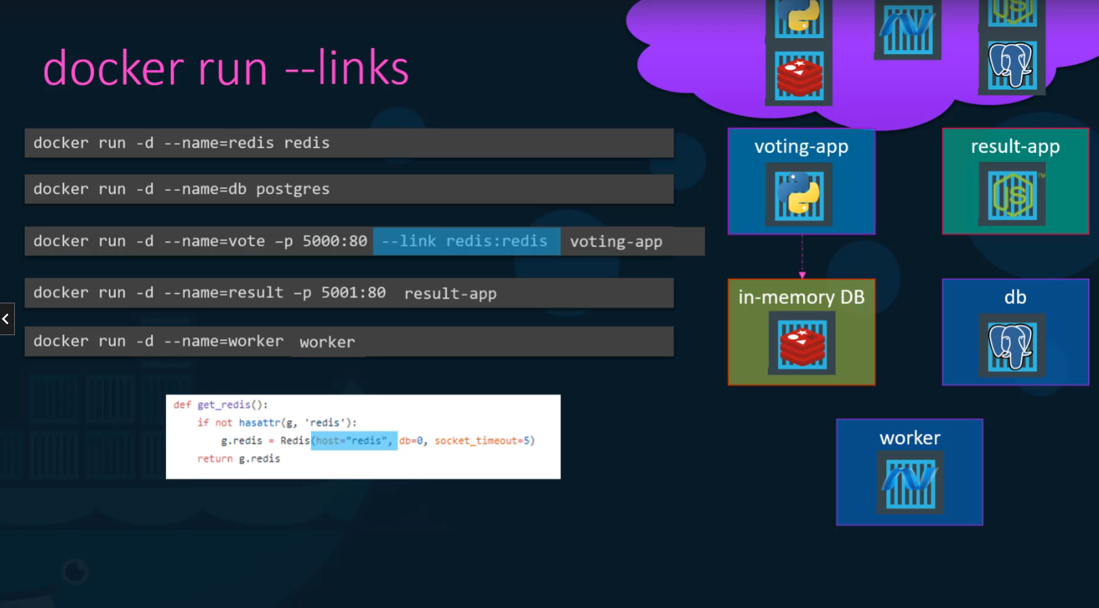

Slide 36
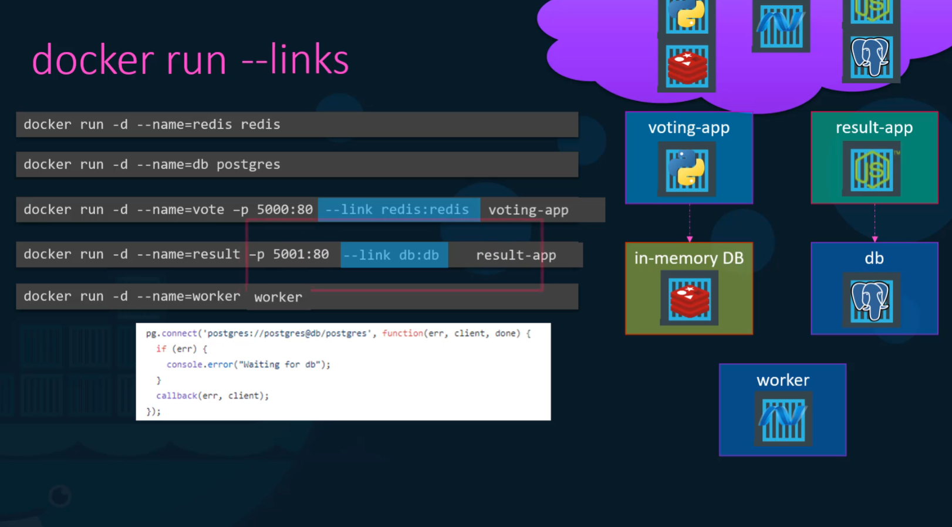

Slide 37
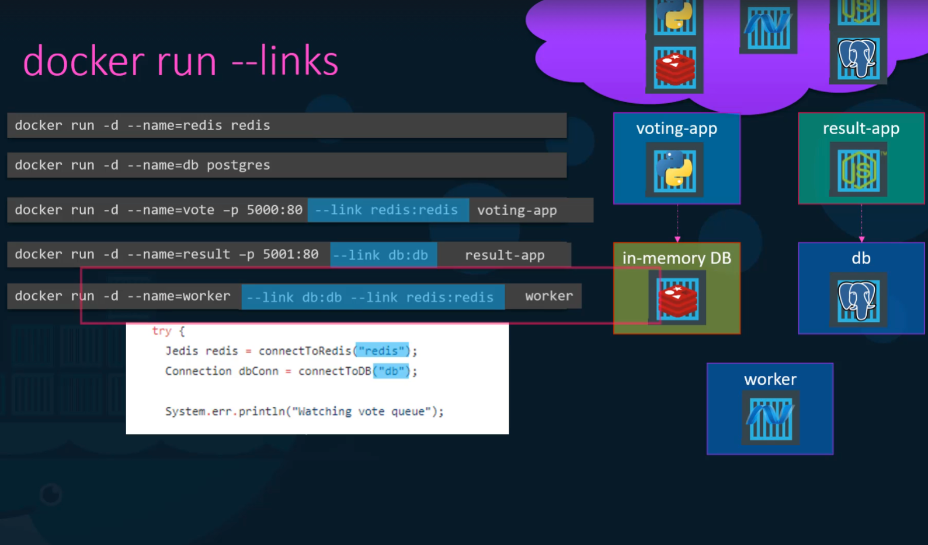

Slide 38
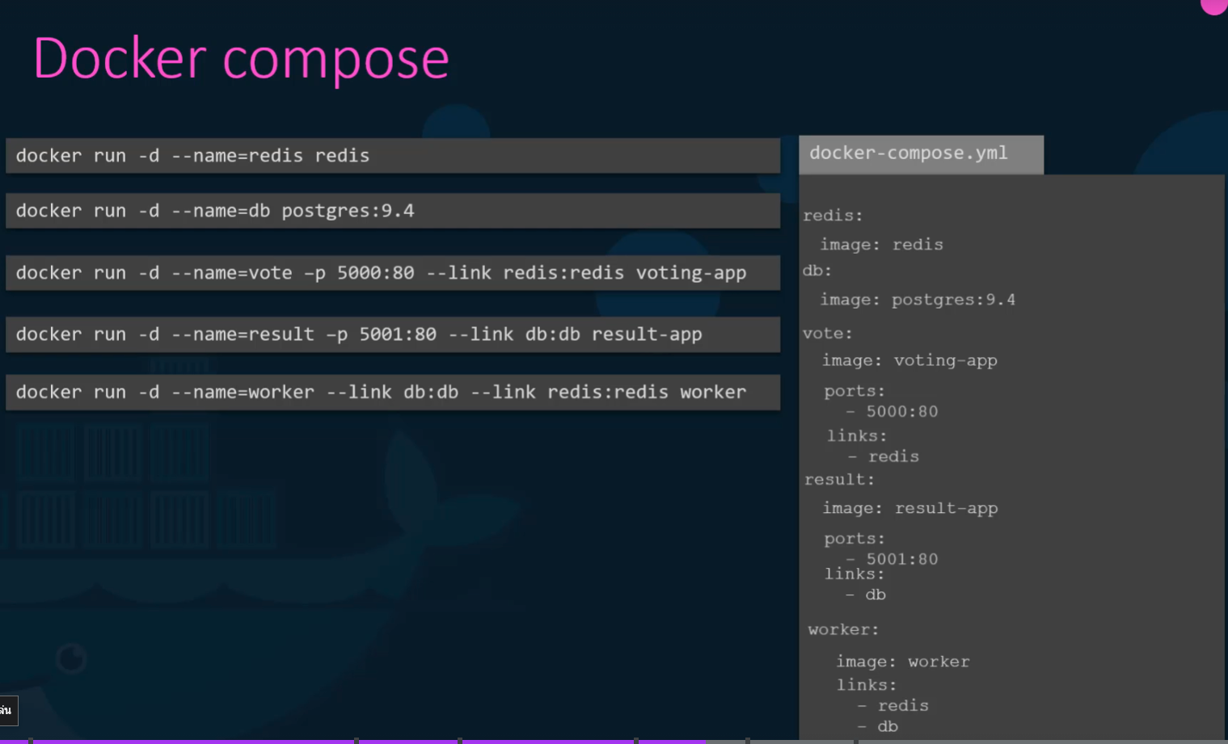

Slide 39



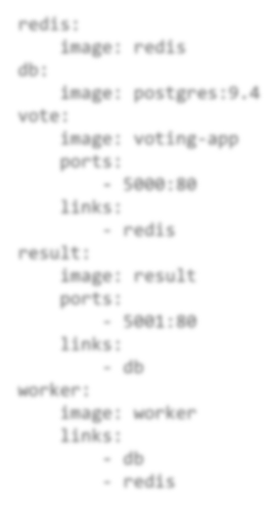
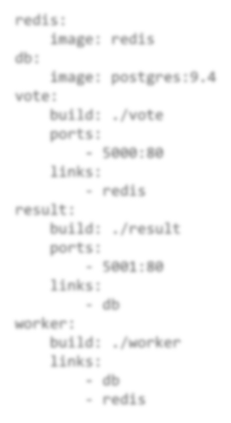

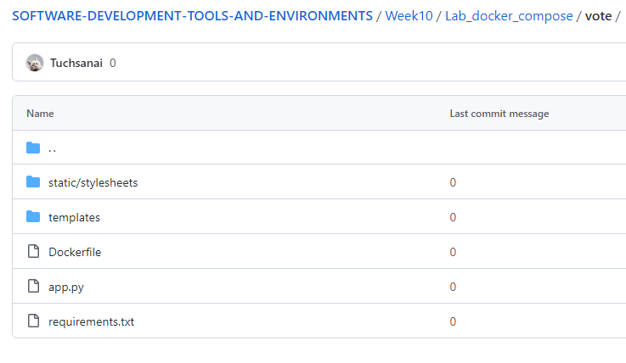
Docker compose - build
docker-compose.yml docker-compose.yml
redis:
image: redis
db:
image: postgres:9.4 vote:
redis:
image: redis
db:
image: postgres:9.4 vote:
image: voting-app
ports:
build: ./vote
ports:
- 5000:80
links:
- redis
result:
- 5000:80
links:
- redis
result:
image: result
ports:
build: ./result
ports:
- 5001:80
links:
- db
worker:
- 5001:80
links:
- db
worker:
image: worker links:
build: ./worker links:
db
redis
db
redis

Slide 40
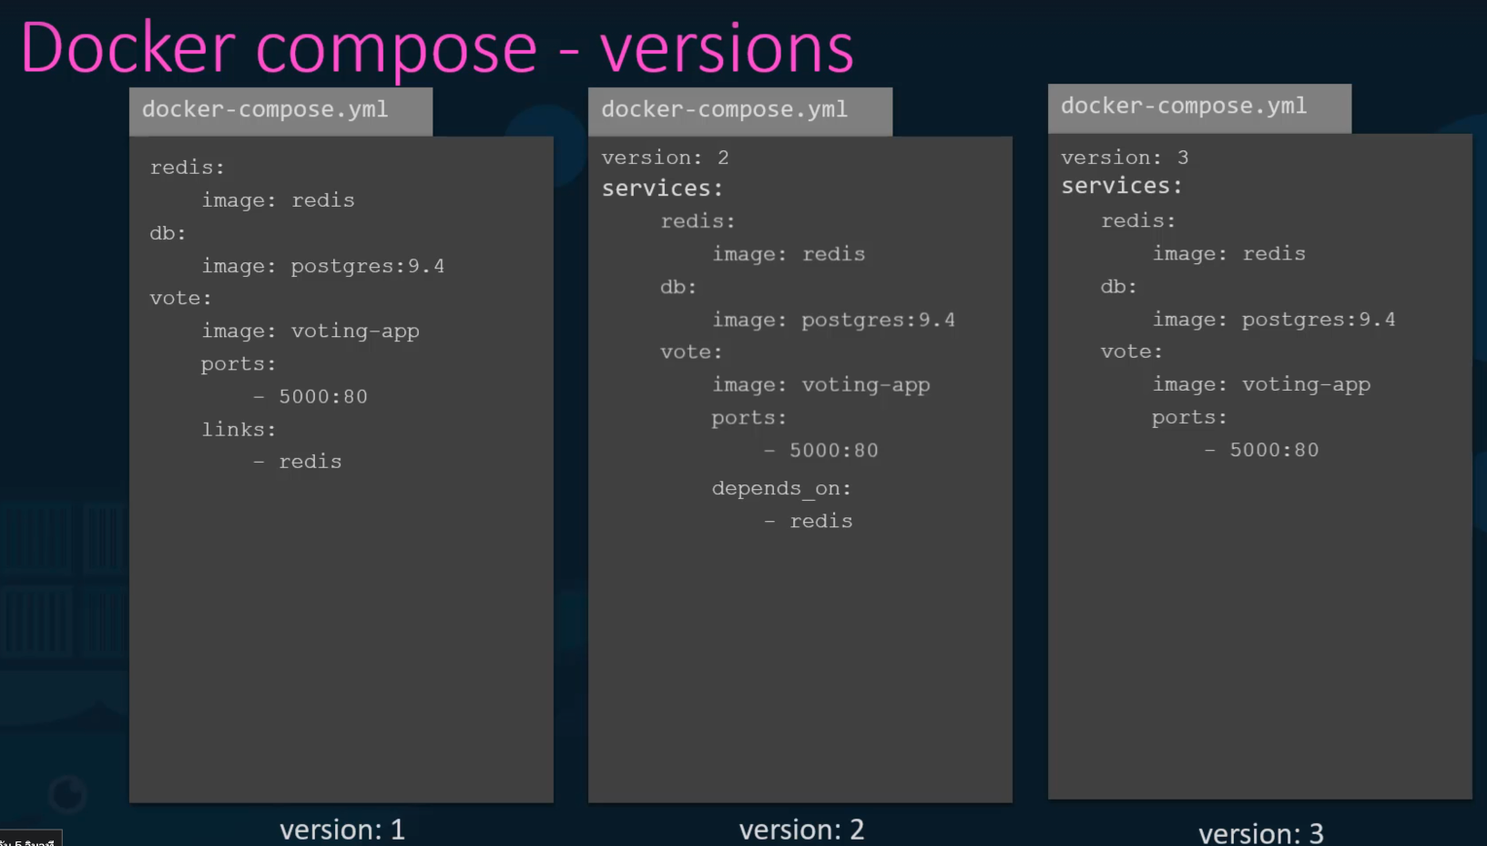

Slide 41



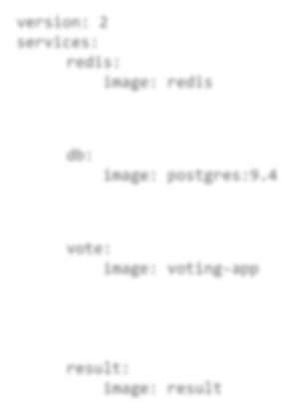




Docker compose
docker-compose.yml
version: 2 services:
redis:
image: redis
networks:
front-end
voting-app
result-app
back-end
image: postgres:9.4
networks:
back-end
vote:
image: voting-app
networks:
front-end
back-end
result:
image: result
networks:
front-end
back-end
networks:
front-end: back-end:
db:
redis
db
back-end
worker

Slide 42
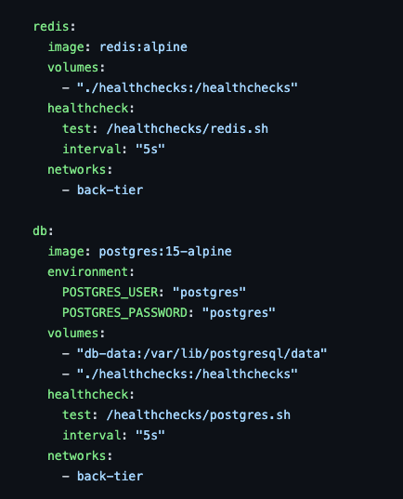
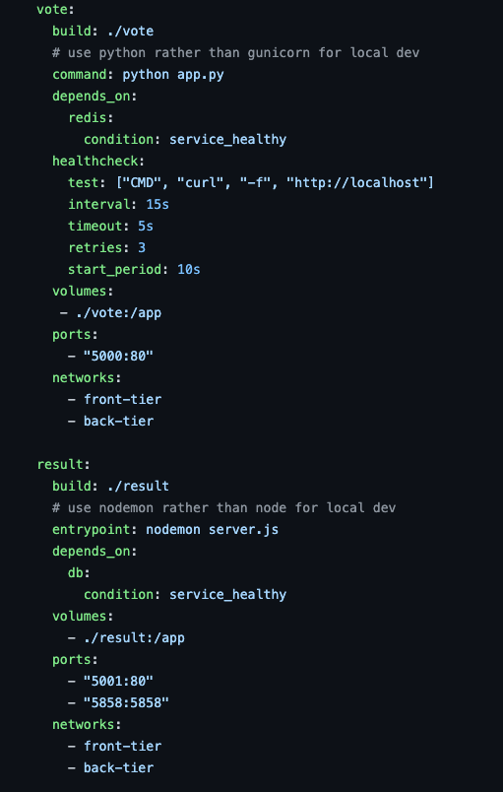

Slide 43
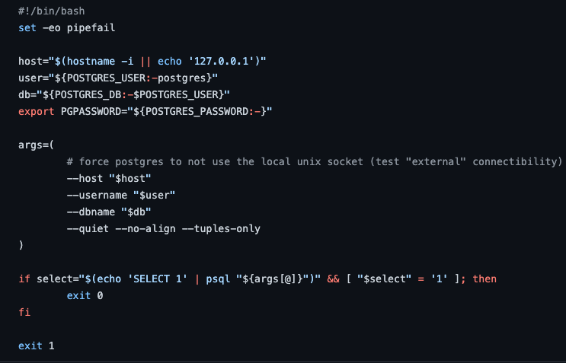
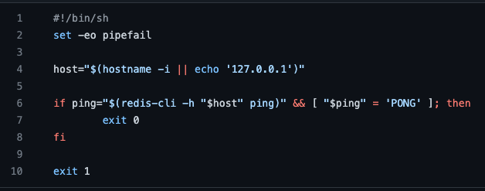
redis.sh
postgres.sh

Slide 44
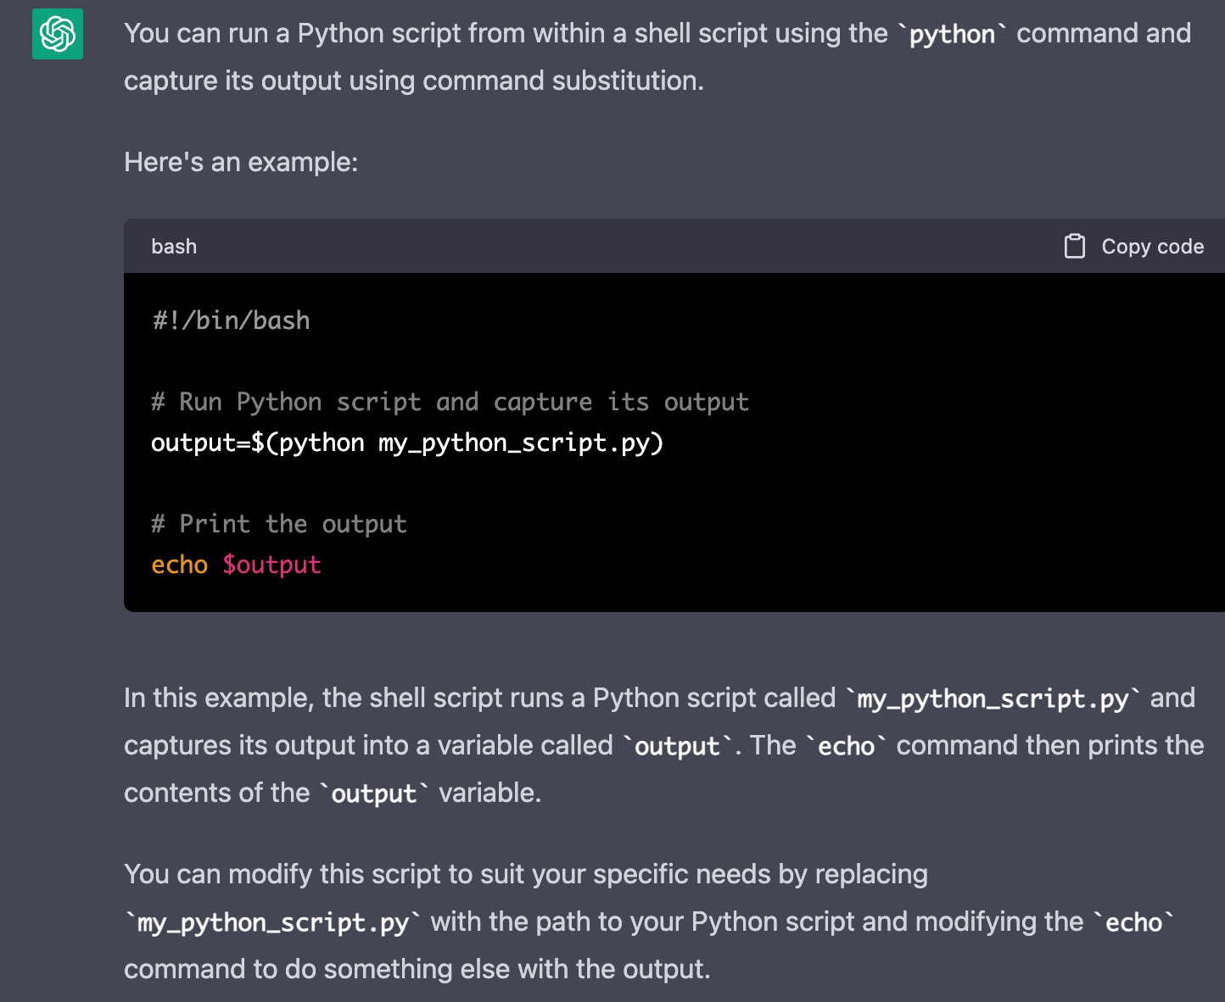

Slide 45
